Slide 1

Pinnacle Rental Case
SARAVANA KUMAR LOGANATHAN

Slide 2
Vision Statement
The main objective of developing a new information system for Pinnacle rental is to automate monotones jobs, reduce error, provide innovative service to customers and suppliers, and improve Pinnacle’s efficiency, speed, flexibility and morale.
Business Problem
Information System
Business Solution
Management
Tools and technology
Organization
Automated system
Manual System

Slide 3
Today’s Situation
Pinnacle Rentals operates three stores in the area, the stores are operated individually with no sharing of information and rental items.
The current working system of Pinnacle is operated manually.
Each Pinnacle Sore maintains three different files that are maintained by the Clerk- Customer Info file, Item Info File and Rental Info File. The file system overhead the management to run continuous training for the new staff to ensure they follow correct procedure.
The system provides no delivery option.
Either no financial reports are generated in the current system or they are generated with great difficulty as it consumes a lot of time.

Slide 4
Goal and Objective
The objective of the project is to implement a new information system that can automate the billing process and retain data of the rented items of all the stores.
The new system also includes development of a web based application that is to be designed to keep all chains of Pinnacle Rental linked in, to administer its users and customers and provide an online rental facility to its customer.
The proposed project will provide a precise, suitable, secure and systematized system that would reduce manual process and eliminate any inaccuracies.

Slide 5
Anticipated Benefits
The system will avoid long queue for customer’s billing counter by minimizing the average checkout to 2 minuets (Speed up execution).
Increase overall revenue of the company by approximately 25%, hence hold a stronger position within the market.
Minimize the number of employees from 15 full-time and 5 part-time to 9 full-time and 2 part-time thereby scale back the value of labor.
Hold a common web application for all three stores of Pinnacle, thereby keep track of all the obtainable items within the stores by using one shared database.
The system will be less vulnerable to errors and minimize loss of information as the system will be automated.
Provide an online choice to the customers to get their item online via website
Increase sales opportunities approximately by 25%

Slide 6
Scope
Unified Information System
The scope of this project is to provide a unified information system that can manage customer’s account, rental item details, billing, checkout, report generation for all three stores of Pinnacle
Web Application Development
The system includes an web application development that is to be designed to keep all chains of Pinnacle Rental linked in, to administer its users and customers and provide an online rental facility to its customer. (Refer Notes for Details)
To win back business from major players Pinnacle will not just be restricted to pick items but also prepare them for shipping . Based on the distance the store will provide same day delivery or 2-day delivery options.
Distribution System
Notes:
Employee Page:
Login for the employees
Maintain Customer details- Update/Add customer’s information
Sales/Inventory Management -Update available and new item details of all three chain of pinnacle (Read data from the barcode and transfer the information to the system storage)
Provide a billing page that will accept payment through cash and Debit/credit card.
Generate monthly/yearly financial report.
Generate monthly/yearly inventory report
Generate a monthly report to capture data about customers purchase and analyze them to learn more about customer preferences and sale trends
Direct to an output screen that would generate billing receipt, display the total amount of item purchased and return cash (if needed).
Customer Page:
Online Catalogue/Quotation of Pinnacle.
Distribution/Transport Management- Choose Delivery Option-Pick up or drop.
Search System- View items available in all three chains of Pinnacle.
Registration/ Login for the customers.
Payment gateways- Debit card, Credit Card and PayPal.
Customer’s account management- Customers can manage their account and check status of their items.
Online Customer Care Service- Email or phone

Slide 7
Out of Scope
Payroll Handling
Mobile Application
Application is to be developed only in English. All other languages are out of scope.
As part of the online customer service, Online chat out of scope.
Shipping is restricted to US* only ( * Up to 200 miles from the store )

Slide 8
Level-0 DFD

Slide 9
Level 1 DFD

Slide 10
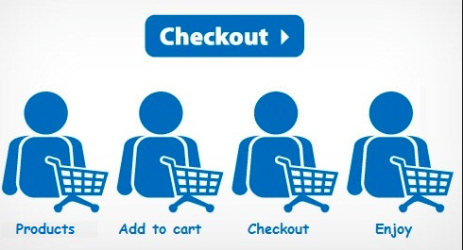


Proposed System
Screens
Reporting

Slide 11
Pinnacle Rental – In Store

Slide 12
Employee Login- Security Page
User name- Employee Login ID
Password- Case Sensitive
Forgot Password- Redirect to a new screen for Password assistance.
Stay logged in –Remember user name and password on the system.
Create an account - Directs to a new screen for account creation for new users.
Notes:
User name textbox:
1- Must Contain at least 6 characters and maximum 12 characters.
2- Accepted Characters are letters and number only.
Password textbox:
1- Contain at least 6 alphanumeric characters.
2- Contain both upper and lower case letters.
3- Contain at least one number (for example, 0-9).
4- Contain at least one special character (for example,!$%^&*()_+|~-=\`{}[]:";'<>?,/).

Slide 13
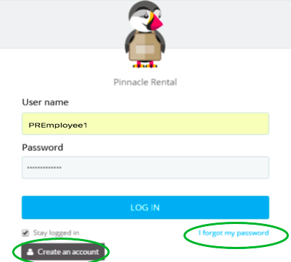
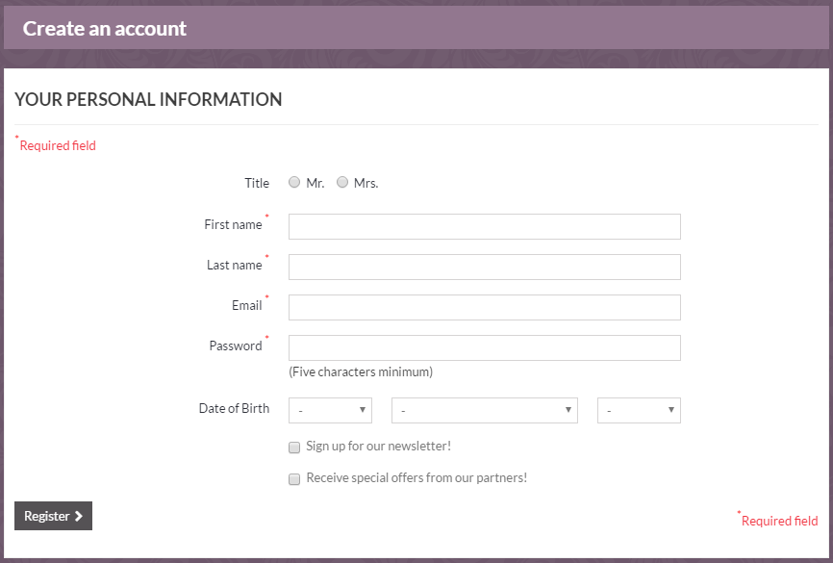
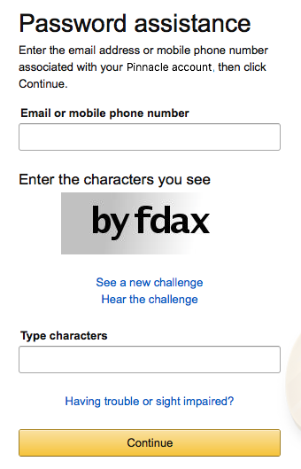
Login- Security Page Cont..
Create an account Page
Password Assistance Page
Notes:
Create an account Page Password Assistance Page
*Require Field User can set new password by entering the email address or mobile number associated with Pinnacle Rentals.
Password Construction Guidelines:
1- Contain at least 6 alphanumeric characters.
2- Contain both upper and lower case letters.
3- Contain at least one number (for example, 0-9).
4- Contain at least one special character (for example,!$%^&*()_+|~-=\`{}[]:";'<>?,/).
Email requirement:
1- email must contain @ signs.
2- email must contain valid characters.
3- email must contain both TLD’s (.com, .net, .edu, etc.) and LLD’s (gmail, aol, Hotmail, etc.)

Slide 14
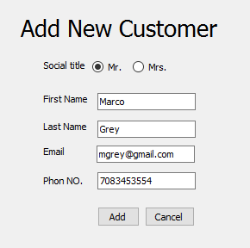
Store Checkout System
Each item in Pinnacle Store will be uniquely labeled with a barcode label and all customers will have a unique Customer Id .
The barcode scanner will scan the barcode label of item and membership card of the existing customer and fill in the item no, item name ,item price and Customer details(For existing customer)
Store employees can add new customer details and issue them membership card .
Store employee can then add rented items Start date, end date, price and quantity for the item.
They can then choose the payment method via Cash, credit or debit card.
At last confirm the order and print receipt or decline the order.
Notes:
Item no., item name, price start date and total textboxes are read only
Number of quantity must be at least one and maximum 100
Minimum time to rent product is one day
Maximum time to product is 12 month
First name and last name textbox accept only letter.
Email requirement:
1- email must contain @ signs.
2- email must contain valid characters.
3- email must contain both TLD’s (.com, .net, .edu, etc.) and LLD’s (Gmail, aol, Hotmail, etc.)
Phone No. textbox must accept number only and must be 10 digits

Slide 15

Pinnacle Rental Online- Home Page
Notes:
Scope is limited to:
Only English Language.
Only Dollar($) as currency

Slide 16

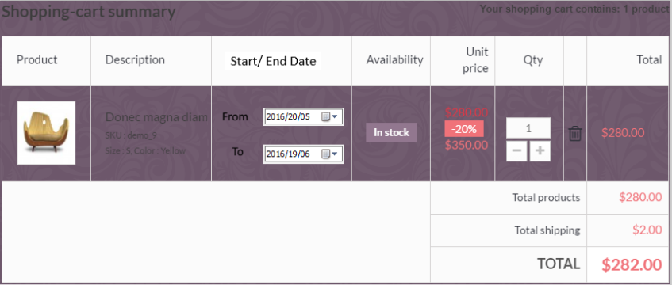
Shopping Cart
Pinnacle hosts several items listing and allows customers to rent multiple items in one single checkout process. There’s no need to complete a checkout after each purchase. Customers can select n* number of items and add them to cart and Pinnacle will combine all rented fee and shipping fee into one consolidated invoice.
Notes:
n* - Number of items should be 0 > n < =100 to generate invoice.
Number of quantity must be at least one and maximum 100, (depend on availability)

Slide 17
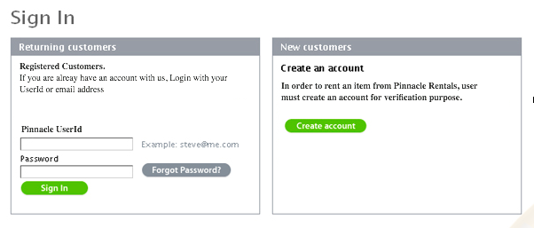
Online Authentication
In order to rent an item from Pinnacle Rental, the customer must have an account for verification purpose.
Existing customers can login with their existing Pinnacle User Id/email address and Password.
New customers are required to create a new account in order to proceed with checkout.
Notes:
*Require Field
Password Construction Guidelines:
1- Contain at least 6 alphanumeric characters.
2- Contain both upper and lower case letters.
3- Contain at least one number (for example, 0-9).
4- Contain at least one special character (for example,!$%^&*()_+|~-=\`{}[]:";'<>?,/).
Email requirement:
1- email must contain @ signs.
2- email must contain valid characters.
3- email must contain both TLD’s (.com, .net, .edu, etc.) and LLD’s (gmail, aol, Hotmail, etc.)

Slide 18
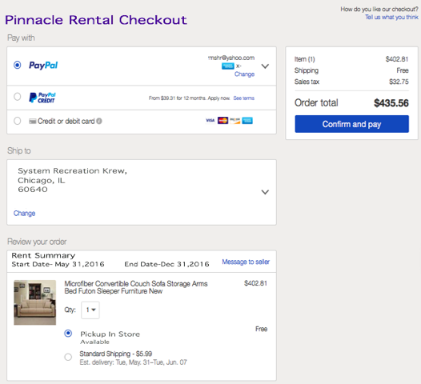
Pinnacle Rental Online Checkout Page
Offering customers safe and convenient payment choices can help earn positive feedback. Therefore Pinnacle website is proposed to offer three payment options:
PayPal
PayPal Credit
Credit or debit card
It also offers delivery options such as
Pick up in store
Standard Shipping
Shipping is restricted to 200 miles from the store.
*Shipping Charges and Est delivery will be based on the distance from the store.

Slide 19
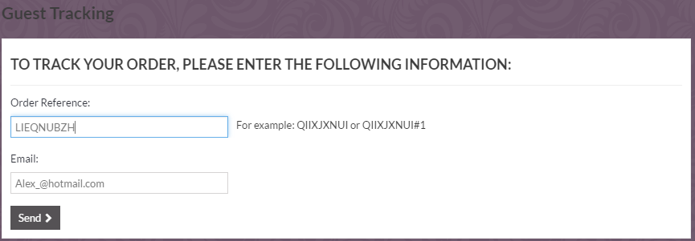
Track Order
After each purchase at Pinnacle Rental if a customer chooses delivery option , customer will be provided with a tracking number to track the status of their delivery.
Customers can login to the Pinnacle Rental website and track their item by providing Order Reference Number and/or Email associated with Pinnacle Rentals.
Notes:
Customers can track their order by providing Order Reference Number and/or Email associated with Pinnacle Rentals.(Either one or both are accepted as inputs)
Order reference text requirement:
Must be 10 digit (numeric, letter) only
Email requirement:
1- email must contain @ signs.
2- email must contain valid characters.
3- email must contain both TLD’s (.com, .net, .edu, etc.) and LLD’s (gmail, aol, Hotmail, etc.)

Slide 20
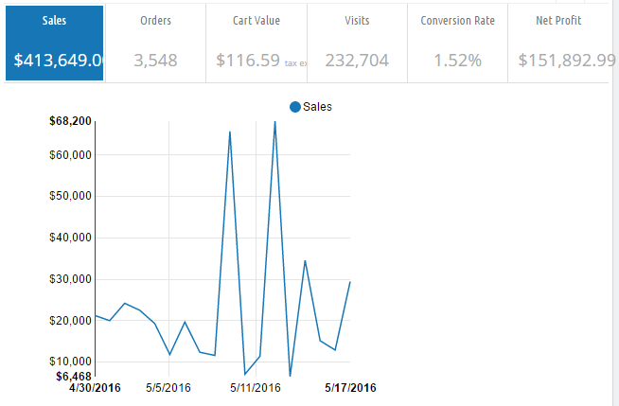
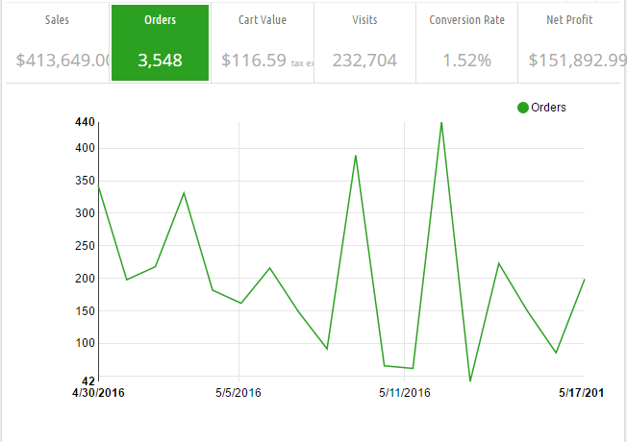
Financial Reports-Monthly
Notes:
Monthly Pinnacle Rental sample sales and order reports for all three stores, individual store, or online store.

Slide 21
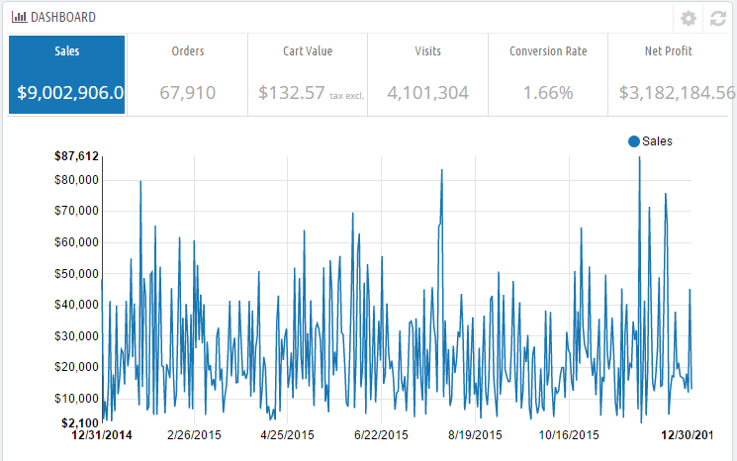
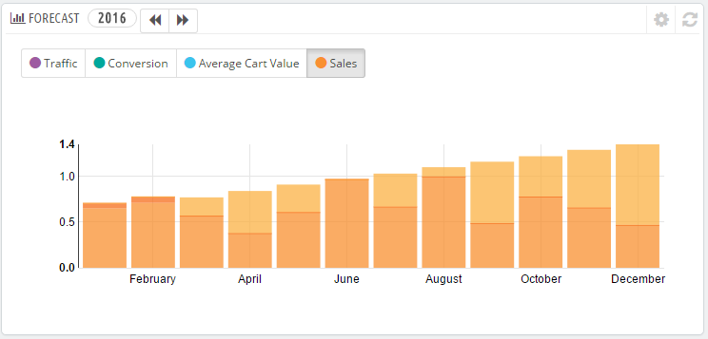
Financial Report -Annual
Notes:
Annual Pinnacle Rental sample sales and order reports for all three stores, individual store, or online store.

Slide 22
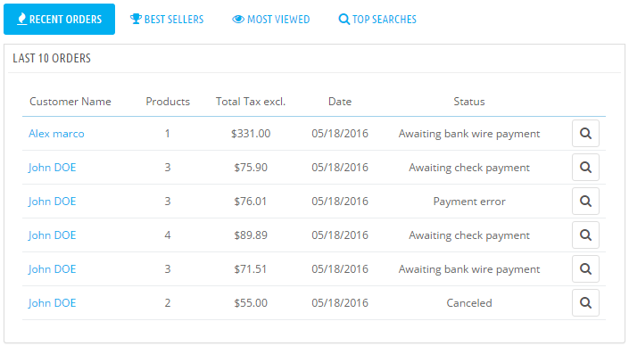
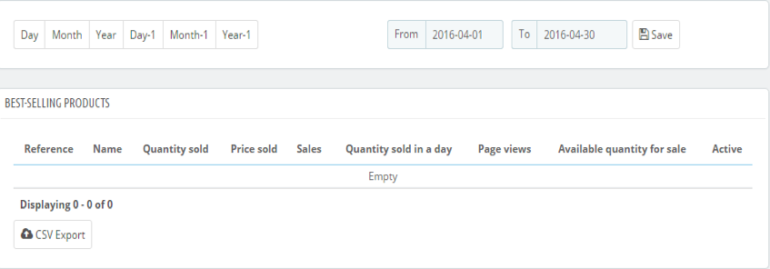
Summary Report
Summary report can be generate Daily, Weekly, Monthly or Annually reports in order to:
Capture sales data
Check Best selling and Most Viewed product to help analyze customer preferences and sale trends.
Notes:
Generate Daily, Weekly ,Monthly and Annual reports to :
Capture sales data
Best selling and most viewed product report to help analyze customer preferences and sale trends.
**Export button: Export report to an excel file

Slide 23
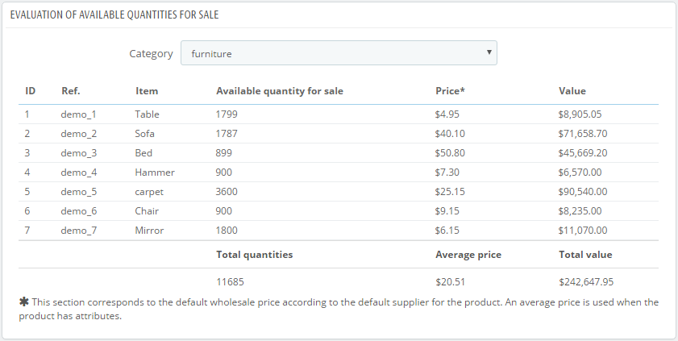
Inventory Report
Inventory report is a complete listing of all data for every product listed in the inventory by category. It also provides a sum of quantities, price and total value of the items.
Notes:
Inventory reports can be filtered based on the Item Category.
Inventory Report for all the items can also be generated by selecting Category as: All items.

Slide 24
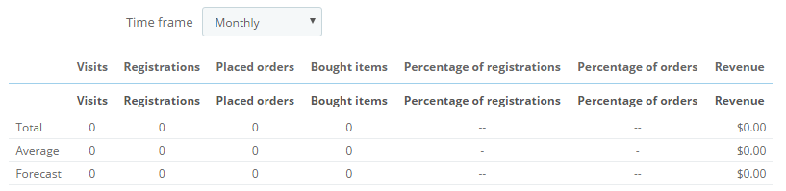
Statistics of Online Pinnacle Rentals
Online store’s administrators and managers can see daily, weekly, monthly, or annually statistics about online users or visitors such as how many visitors or registrations in the website in a particular month. They can also check the statistics about the online products such as how many products were bought in a particular month.

Slide 25
It is essential to conduct training prior to implementation of the new system. One week in-house training will be provided to the following roles :
Training
Pinnacle Rental Employees
New System Overview
Log-in and Log-off Screen
Main Menu and Sub items
Key terms
Create new account for customers
Icons
Major Checkout system function
Troubleshooting guide
Store Administrator &Store Managers
Project Scope and Anticipated Benefits
Cost-Benefit Analysis
Key IT Support
Major Screens and Reports
Employee Training
IT Staff
Project Overview
System Documentation
Technical Training
User and Management Training
Problem Solving
Notes:
Training is part of the change management , Phase IV
In –house Training will be provide for Pinnacle Rentals:
Training will be provided in groups mentioned in the Training Plan as intended Participants.
One week training will be provided via live examples and set of presentations.
Once the training is completed , a complete scale test will be performed by the Pinnacle Rental employees.

Slide 26
Training Plan
Course | Description | Intended Audience | Session Date/ Length
Getting Started(New System Overview/Log in/Log out) | Overview of the New System, Anticipated Benefits and Log in/out in the system. Online Ordering and tracking, Automate billing. | All Pinnacle Rental Staff- Employees, Managers | 09/06/16 2 Hours
Checkout Screen(Creating New Customer, Payment Process, Delivery, Display) Saving Information | Complete store checkout process, new customer profile creation, Scanning Item details, Delivery options and payment options and keep track of all the obtainable items within the stores by using one shared database | Pinnacle Rental Employees | 10/06/16 2 Hours
Standardizing data entries, Differentiating between suggested vs required fields | Maintaining a standardize process across all chains of Pinnacle and detailing about the mandatory information’s required for the process and Employee’s monthly, weekly performance reviews. Also, Evaluating sales Order Value. | For all levels | 13/06/16 1 Hour
Pinnacle Rental Reports | Retrieving/Locating and Saving Financial, Inventory and Summary Reports | Administrator and store Managers | 14/06/16 2 Hours
Online Ordering and Tracking Delivery | Tracking Delivery for store and Online Purchase items. Then, virtual training for accessing or placing an item order to the customer’s from anywhere, when they are requested. | Pinnacle Rental Employees | 15/06/16 45 Mins
Getting help from It Support | Troubleshooting technical issues regarding database error or maintenance. | For all Level | 16/06/16 1 Hour
Maintaining Privacy and Security assessment | If a new techniques are impractical by any malfunctions, then salespeople will get strong hostile with the customers. To avoid, an overview on how to ensure privacy, security and confidentiality of information in the new system. | For all Level | 17/06/16 1 Hour

Slide 27
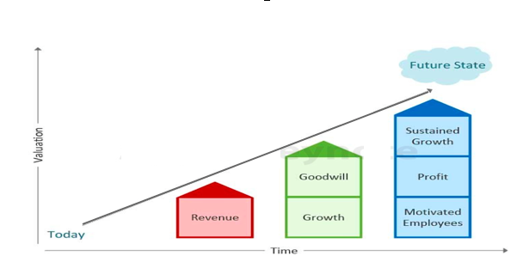
Change Management
Purpose
The new technology changes will eliminate inefficiencies and reductant step from the current process.
Standardized methods and procedures will be followed across all three store of Pinnacle.
Competitiveness and sustainability in the changing market place
With new technology comes more efficient and economical methods to perform work.
Manage and Minimize Business Risks .
Manage employee resistance to change
Increase probability of PROJECT SUCCESS.
Notes:
The main purpose of Change Management at Pinnacle Rentals is to ensure that:
Understand the purpose of change management
Define major processes affecting change in people
List challenges/issues in changing organizations
Describe methods available to achieve change
Develop a change management plan for implementing a system

Slide 28
Factors involved for Change Management at Pinnacle
Need to Improve Process
Increase in Efficiency and Effectiveness
Desire for Growth
Internal Factors
Technology
Economics
Competition
External Factors.
Notes:
A Proper Change management Plan is required as the “to –be ” process will ultimately take away work that the people perform, which may cause a whole bunch of irate people worried about their jobs.

Slide 29
Change Management Plan
Phase | Event/Task | Date/Time | Purpose | Method
Phase I | Awareness | 10/05/16 1 Hour | Inform Pinnacle Rental about the Change Project Kick-off | Staff Meetings Announcement
Phase II | Understanding | 15/05/16 1 Hour | Comprehend the nature and intend of the change and develop an understating of what this change will mean Prepare Change Management &Communication Plan | Welcome Letters Face-to-Face sessions with the store employees.
Phase III | Positive Perception Commitment | 20/05/16 1 Hour | Engage Pinnacle rental employees in developing a positive perception of the change | Announcement of website going live Brochure/Emails sent to regular customers about the new online store and delivery options
Phase IV | Training Move to Action | 01/06/16 1 week | Training Job Transition Guide Organization Alignment Toolkits | One week in house training will be provided on how the new System will work. Touch Point Sessions
Phase V | Preparation for Parallel Implementation Adaptation | 09/06/16 1 month 15/07/16 | Bring the change operational in parallel with the old system in order to test strategies, support and system. Track Progress Once the change is operational for 1 month to evaluate its worth and impact, the new process will be completely operational | New System is parallel run with the old System to check any issues. Measure Progress by Surveys and focus group. Bring the New System completely take over the old System

Slide 30
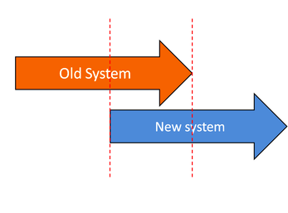
Implementation Approach
To implement the new Pinnacle system, The System Recreation Krew’s team will use parallel conversion approach for 1 months. By using a parallel conversion approach, any discrepancies between the new system and the current process can be identified and fixed. After 1 months of using both system in parallel way, the old system will be stopped and all the three Pinnacle stores will use the new system only.
At the same time, our team will release the online system which will allow customers to rent items online.
Advantages of using Parallel Installation
New system can be checked against old system
Impact of operational errors are minimized as the old system is also processing all data.

Slide 31

Implementation Timetable
Week 1
Collect and Review design specifications for new system.
Identify Components to be installed
Installation of Software, Hardware and Database
Week 2
Week 3
Acceptance testing.
Debug issues if any
Week 4
Week 5
Parallel implementation
Complete Parallel implementation.
Prepare for complete take over by the new system.
Prepare for complete Adaptation to new System
System Rollout
Initiate Parallel approach for Conversion of existing system to new Information System
Training must be preformed prior to implementation of the new system.
Notes:
*Training Program is an prerequisite to Implementation.
Parallel Implementation continues for a month(4 Weeks) to identify any discrepancies between the new system and the current process.
After 1 month the System will be completely taken over by the new system.

Slide 32
Prerequisite & Approach for Conversion Plans
Approach for Conversion Plan
Validate the critical data in the current system
Capture any additional data required for the initial operation of New system
Transfer the data from the Current System to New System
Confirm the results of the conversion process
Prerequisites for Conversion
The New System program is completed, fully tested and approved by the Sponsor
The Employs Staff must be trained about the New System
The complete Support team must be in place to resolve problems arising during conversion and on-going operation of New System

Slide 33



Conversion Plan
All Pinnacle files will be transferred to the new system’s server and entered in the new system’s database. This will allow the stores to keep and maintain their products’ and their customers’ information as well as generate reports by accessing historical data. IT team will be responsible for ensuring a seamless transition of data from the current system to the new system’s servers.

Slide 34

Summary
Pinnacle Current System
Project Objective
Project Scope
Context Diagram
High Level DFD
Proposed System
Screen
Reports
Training Plans
Change Management
Conversion/Implementation Plan

